Slide 1



Welcome!
We are glad you are here today.
Presenter: Sarah Spizale- Insurance Broker

Slide 2
In Your Corner Insurance
About Us:
Core Principles:
We are a local agency that specializes in Medicare Advantage and Supplement Plans.
Our services are free, no cost, and no obligation help.
We offer following plans in your area: Humana, People’s Health, United Healthcare, Aetna, WellCare, Blue Cross/Blue Shield, Ochsner and Medico
Do what is right for you.
Be there to answer your questions.
Exceed your expectations.

Slide 3
Why work with a local Broker such as myself?
They have access to multiply company’s plans
Access to same plans and benefits if you were to call just one for example “ Humana”.
Free-no obligation help.. we get paid from the carrier- Most agencies.
Being a broker, we want what is best for you and fits you. Regardless of the carriers we write for.
Face to face appointments .. more than likely you will obtain more information about your plan.
For instance I come across people that are in the right plan but didn’t know they had benefits they weren’t using.
A good local broker has studied the plans in the area more than a telemarketer located in another state.

Slide 4
What is Medicare?
Federal health insurance program established in 1965.
Available to American citizens and permanent legal residents 65 and older as well as younger than 65 that have qualifying disability.
Over 61 million Americans are covered by Medicare in 2024.
Enrollment is projected to increase by an average of 1.5 million beneficiaries per year though 2029.

Slide 5
Topics Discuss Today
Today’s Agenda
Enrolling in Medicare
Advantage & Supplement
Q & A at end
We will not talk about benefits or cost for specific plans
Medicare Basics
  A
  B
  C
  D
  Supplements

Slide 6
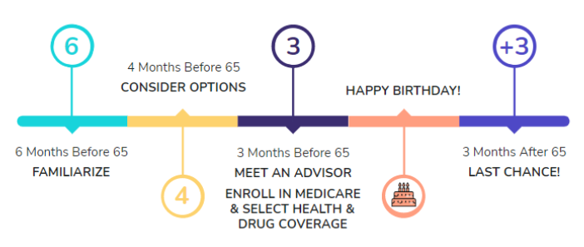
Still working? Leaving Work?
Still Working?
  I’m 65, still working and covered by an employer group plan
  You may delay your enrollment in Medicare Part B and avoid the premiums
  You may enroll in Part B during an 8 month period that begins the month after the employers plan ends or your employment ends.
  Be sure to enroll in Part B during your initial enrollment period so you don’t have to pay a late enrollment penalty!
  Leaving Work?

Slide 7
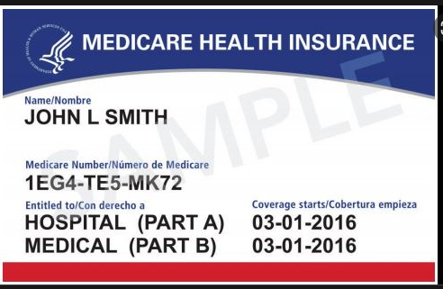
The Four Parts of Medicare
Medicare Basics
  Part A: Hospital
  Part B: Medical Insurance- 202.90 for 2026
  Part C: Medicare Advantage -
    Combination of A&B or A,B&D- Premiums range
  Part D: Prescription Drug Plan- Premiums range
Part A & B :
  Original Medicare’ is Your Red, White, & Blue Card
    It includes Part A(Hospital) and Part B(Medical)
    If you’ve paid payroll taxes for 40 quarters, you will receive Part A at no cost.
  Your Part B premiums will be higher if you have earned $109k Single or $218k filing jointly. IRMMA is a Part B adjustment based on income.

Slide 8
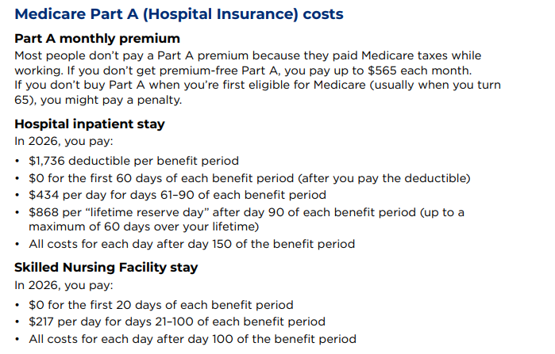
Part A: Deductibles and Co-pays for 2026

Slide 9
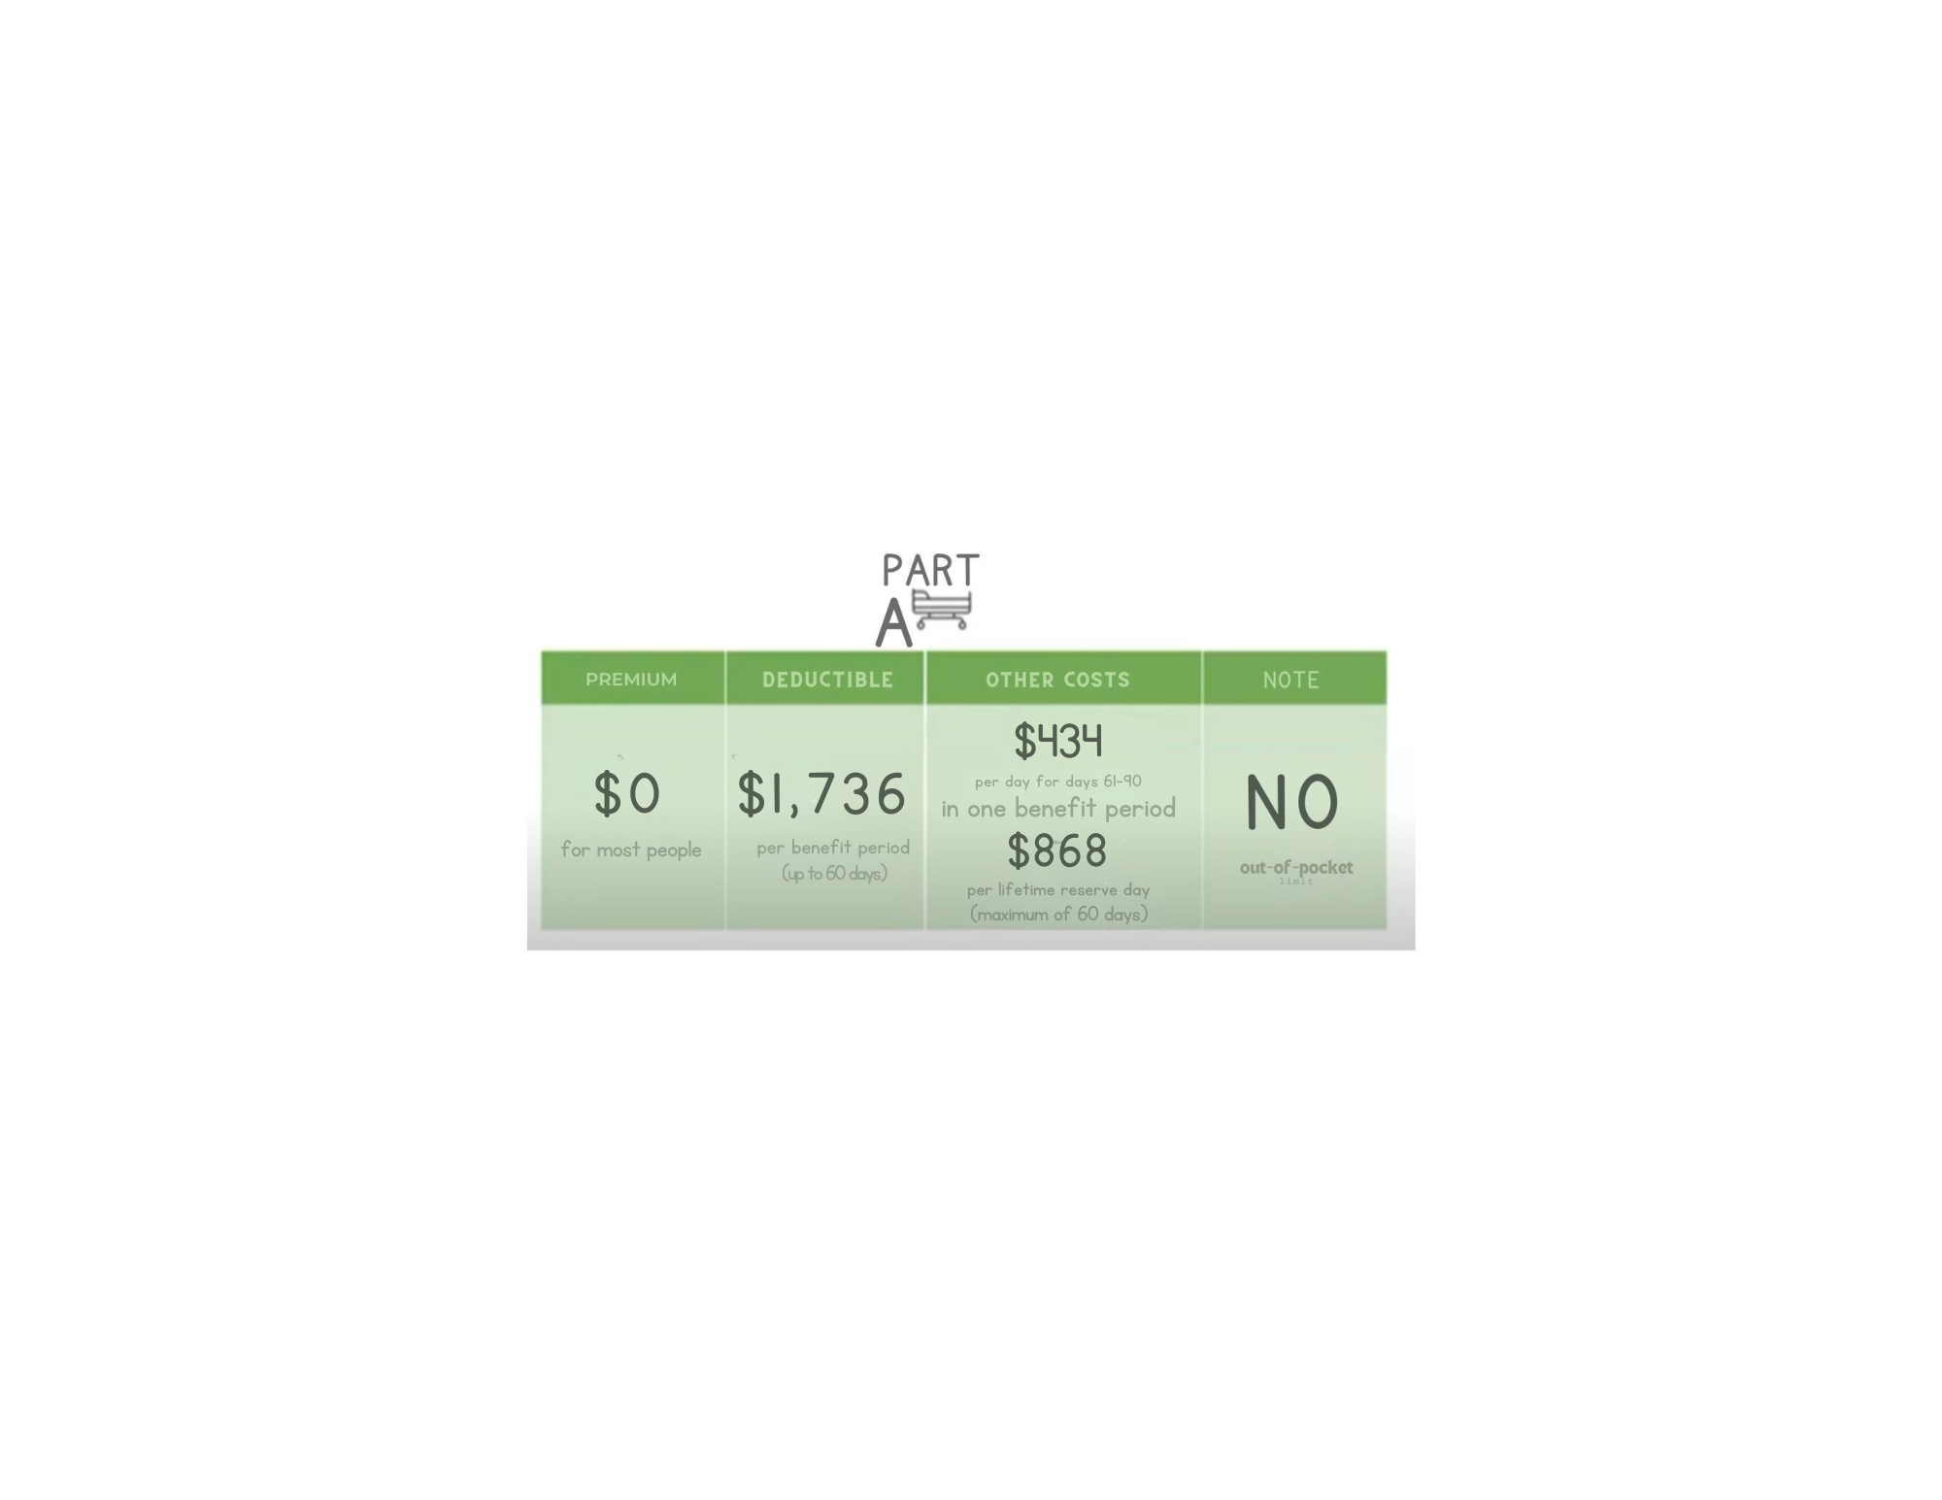
Part A Cost

Slide 10
Part B:Deductibles and Co-pays
Part B Premium 2026
Part B is $202.90 a month.
High income earners pay a higher monthly premium.
Part B Medical Coinsurance 2026
After your deductible is met, you will typically pay 20% of the Medicare approved amount for most doctor services (including most services you get from a doctor while you’re in the hospital), durable medical equipment (DME), outpatient therapy, and Part B drugs such as Chemotherapy.
NOTE: In some states, doctors who don’t accept Medicare may charge an EXCESS CHARGE of up to 15% over and above the Medicare approved amount for covered medical services.
Part B Hospital Deductible 2026
$283 per year
This is the amount you must pay for the medical/outpatient services before Part B will pay.
The deductible does not apply to certain preventive services.

Slide 11
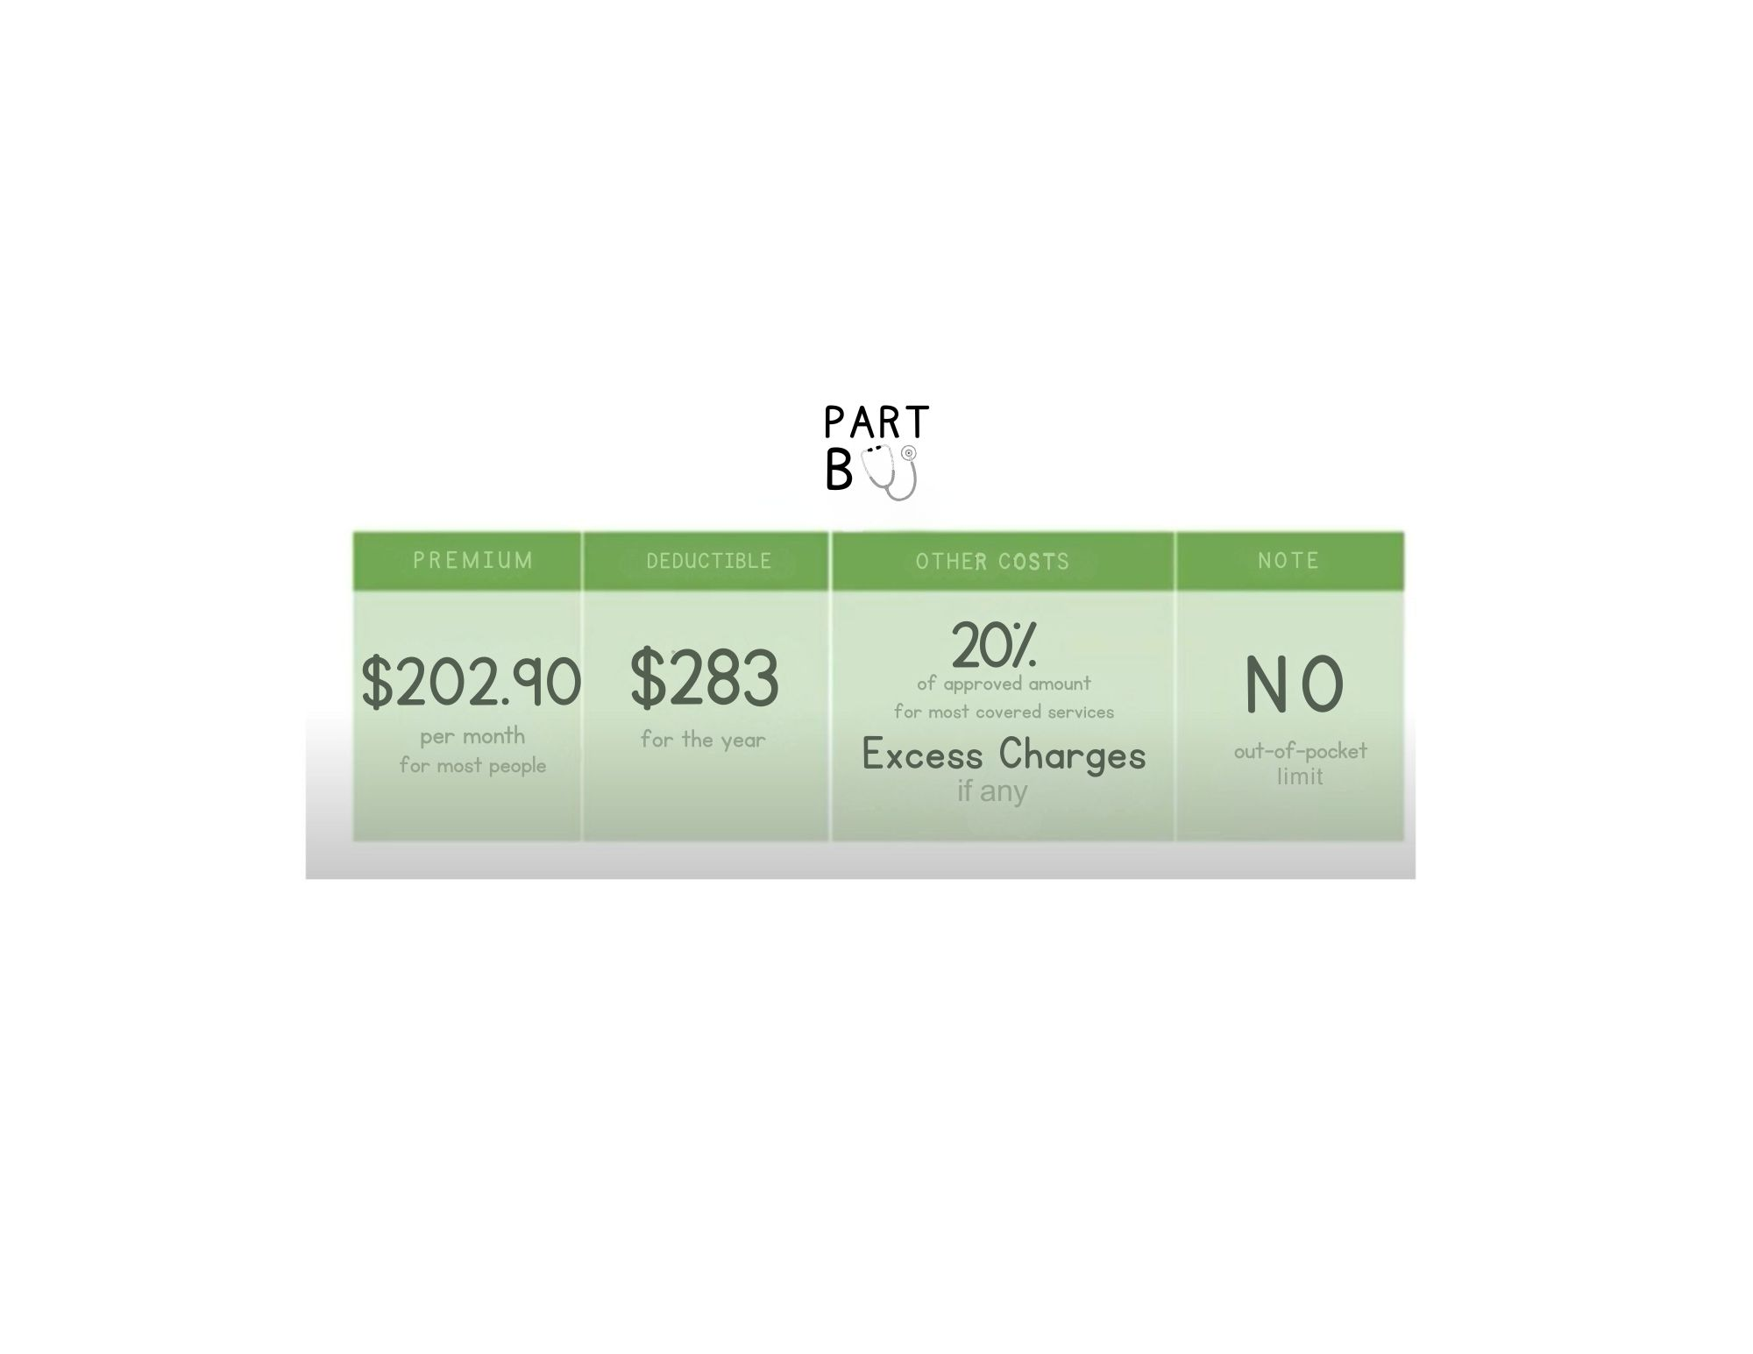
Part B Cost

Slide 12
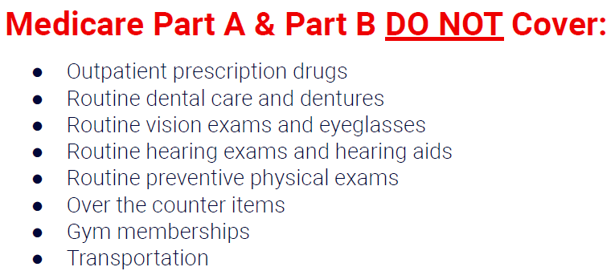
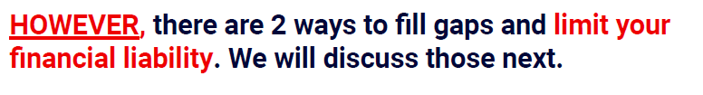
Original Medicare Has Many Gaps in Coverage

Slide 13
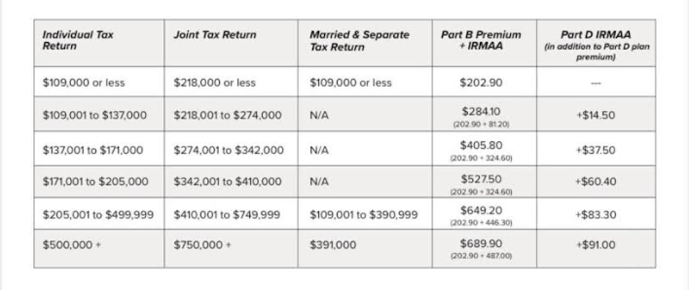
IRMMA-Sliding Scale Part B Premium

Slide 14
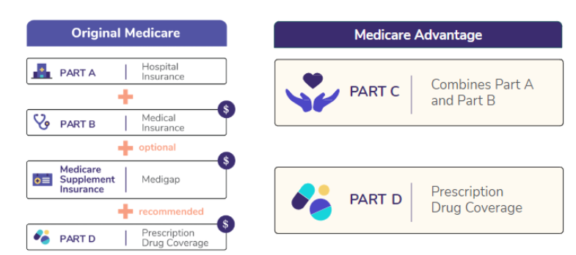
Two Ways to Get Medicare

Slide 15
Advantage VS Supplement
Let’s compare…

Slide 16
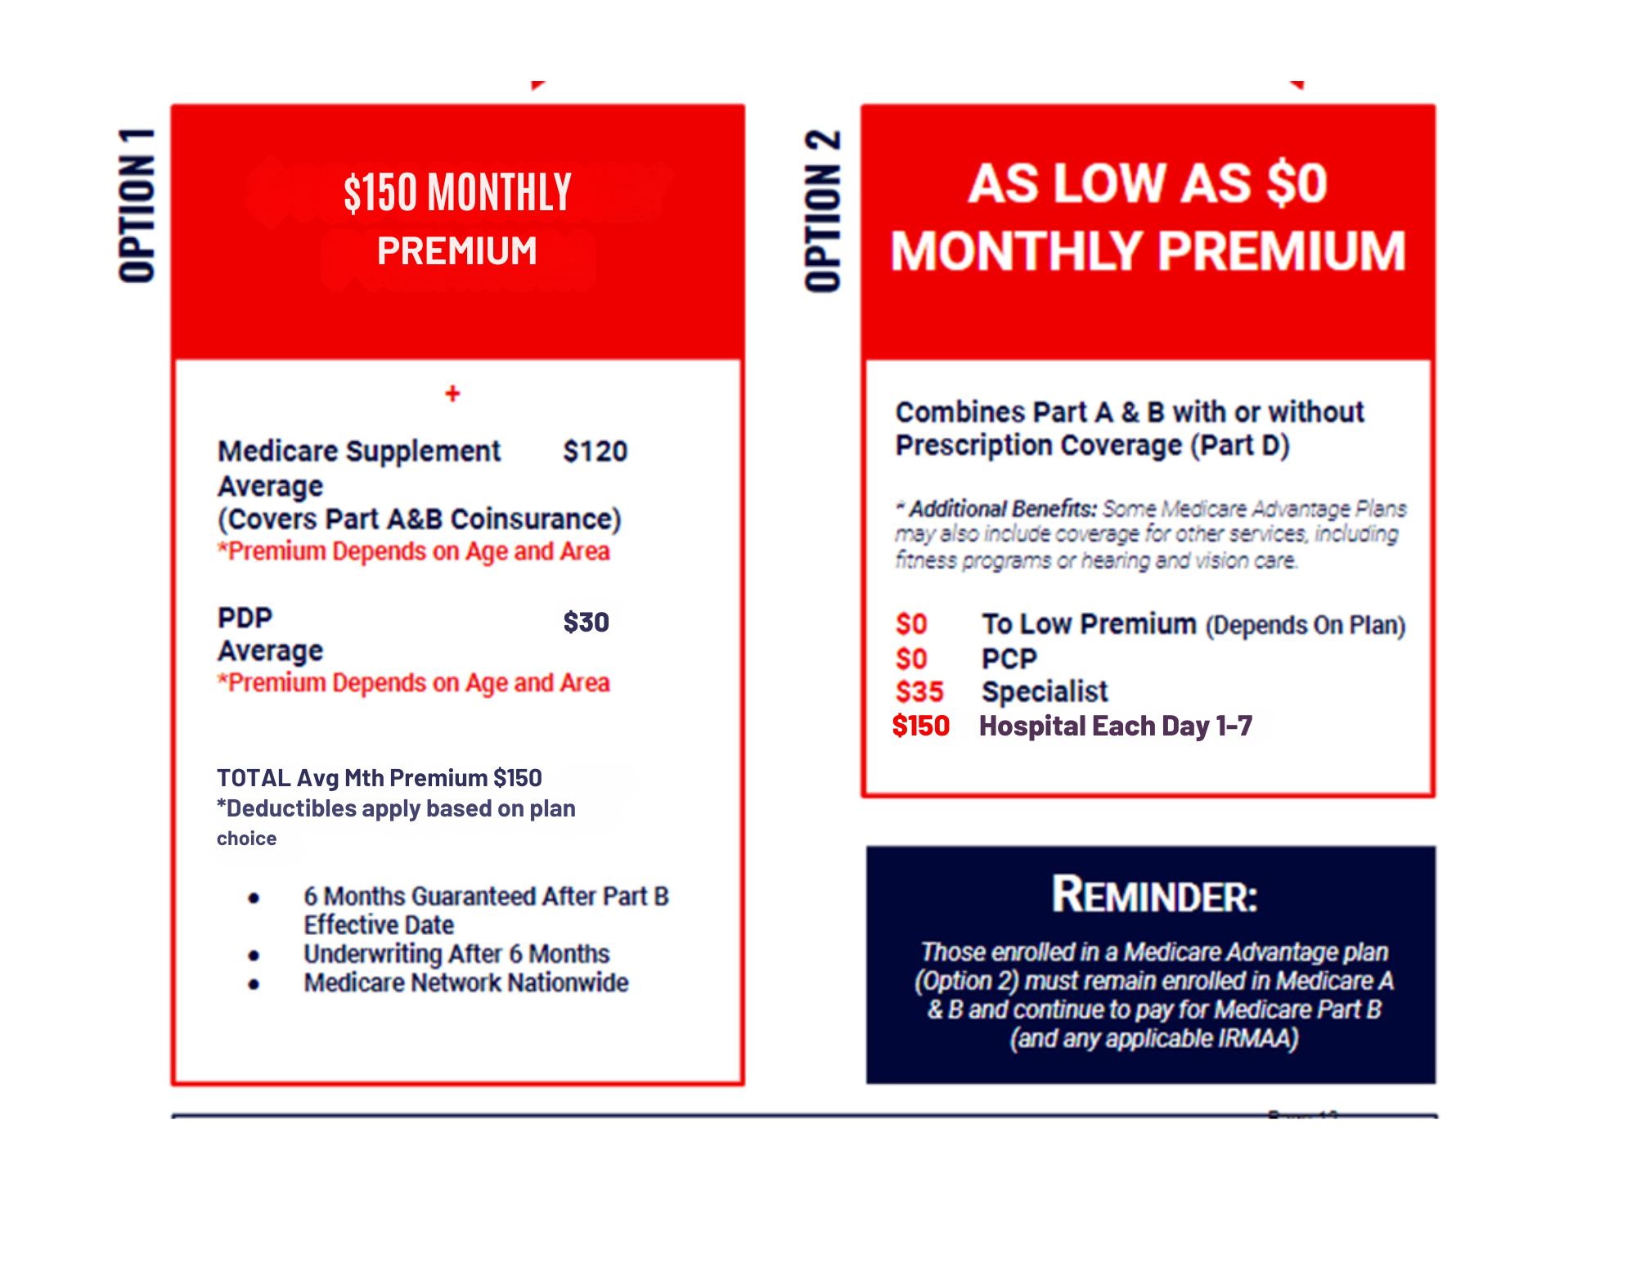
How Do You Want to Receive Your Medicare Coverage?
Regardless of what you choose, you must continue to pay your Medicare Part B Premium of $202.90 plus any applicable IRMAA payments.

Slide 17
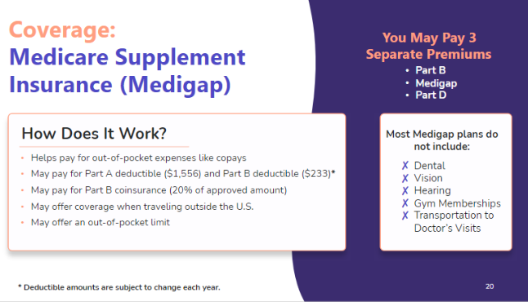
Medicare Supplement Insurance(Medigap)
Medicare Supplement insurance is regulated by your state insurance department.
There are 11 Medicare supplement plans available. A, B, C, D, F, G & High Deductible G, K, L, M, & N
Plans C & F are only available to those beneficiaries Medicare eligible before 2020
Arguably, the most popular of these is Plan G.

Slide 18
What Does ‘Plan G’ Pay?
All Medicare Part A deductibles, copays including an add’l 365 days after Medicare benefits are exhausted.
All Medicare Part B co-insurance (20% that Medicare doesn’t pay), Once you have paid your Part B deductible of $283 for the 2026 plan year.
100% of all Part B excess charges above Medicare approved amounts.
Foreign Travel benefits up to $50,000 lifetime.

Slide 19
Beneficiaries are attracted to Medicare Supplement Plans Because…
Freedom of choice of providers. No networks!
No referrals to see specialists.
Any provider that accepts Original Medicare, accepts Medicare Supplement insurance.
Limited financial exposure.
No benefit changes each year
Guaranteed Renewable – Cannot be cancelled

Slide 20
Medicare Supplement Plans
DO NOT PAY FOR…
Long Term Care (custodial nursing home care)
Vision or Dental Care
Hearing Aids
Eyeglasses
Prescription Drugs
Private Duty Nursing
Routine eye exam for glasses
Any service not paid by Original Medicare

Slide 21
Medicare Advantage Plans Available in your Service Area
Health Maintenance Organization - HMO
Preferred Provider Organization - PPO
Dual Eligible Special Needs - HMO
Chronic Illness Special Needs - HMO

Slide 22
More Medicare Advantage Plan Details
Most HMO plans have a network of providers you must use. PPO plans usually allow you to access “out-of-network” providers at a higher cost.
Co-pays for services like office visits, lab work, surgery ..etc.
Most plans have an annual limit on out-of-pocket expenses. The range is approximately $3,400 to $6,700 in your area
Each plan has different benefits and guidelines.
Most provide prescription coverage. However, a few do not.
Some may require referrals to see a specialist.

Slide 23
Good News! Most Medicare
Advantage Plans Offer..
Routine Dental Benefits (some offer optional add-ons for an additional premium)
Vision and Hearing Benefits
Over the Counter Allowances
Fitness Center Memberships
24 Hour Nurse Hotline
Some Plans even offer:
  Part B premium give back!
  Grocery Allowance and Transportation (Special Needs Plans)

Slide 24
Things to Consider when picking a plan!
If you require a particular specialists or hospitals, ensure the Medicare Advantage plan includes them in the network.
Make sure to verify your medication is in the plan formulary, each plan can have different formularies.
If you live in more than one state or travel often, you may want to consider a PPO.

Slide 25
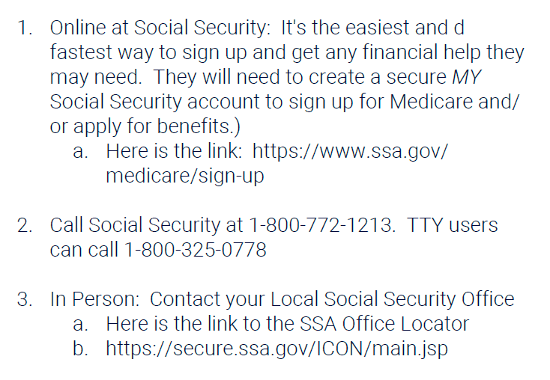
How to Sign up for Original Medicare

Slide 26




Questions? Comments?
We are here to serve you!

Slide 27
THANK YOU FOR COMING!
Sarah Spizale
inyourcorneragent@gmail.com
225-417-3468
Website

